Slide 1
Exam REVIEW Jeopardy
APS106

Slide 2
Rules of the GAME
Form a team with your table or tables around you (sizes ~2-4)
Choose a team name for the scoreboard
Go to https://www.multibuzz.app
Enter the Room Code WGGZQQ and your Team Name
If you get the answer right, you gain the points, and pick the next category
If you get the answer wrong, you lose the points, and the next person who buzzed in is up
Ask questions if you’re confused! Remember, if you’re confused, so are others!

Slide 3
Panel
Return of the Jedi
File and Furious
Key to the Set
Classablanca
The Hitchhiker's Guide to Python
$250
$250
$250
$250
$250
$500
$500
$500
$500
$500
$750
$750
$750
$750
$750
$1000
$1000
$1000
$1000
$1000

Slide 4
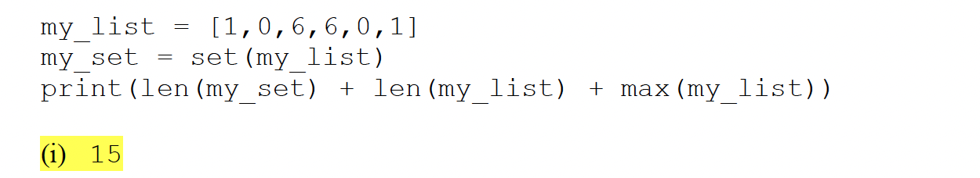
What is the result?
Return of the Jedi · $250
Question board
Notes:
15

Slide 5
Return of the Jedi · $250
Question board
Notes:
15

Slide 6
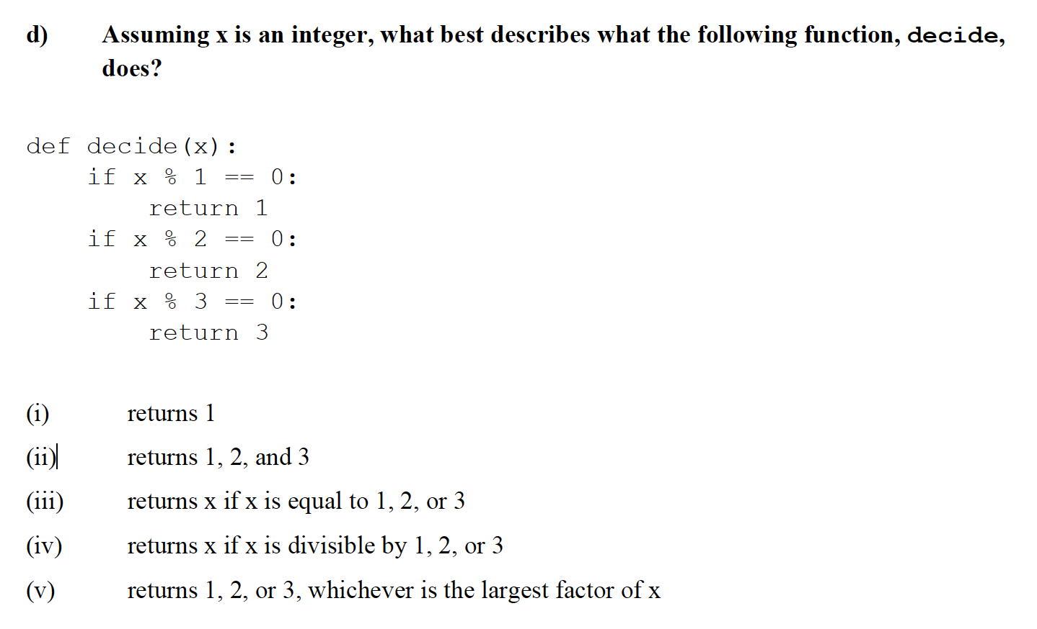
Return of the Jedi · $500
Question board
Notes:
i

Slide 7
Return of the Jedi · $500
Question board
Notes:
i

Slide 8
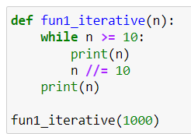
What is the output?
Return of the Jedi · $750
Question board
Notes:
1000
100
10
1

Slide 9

What is the output?
Return of the Jedi · $750
Question board
Notes:
1000
100
10
1

Slide 10
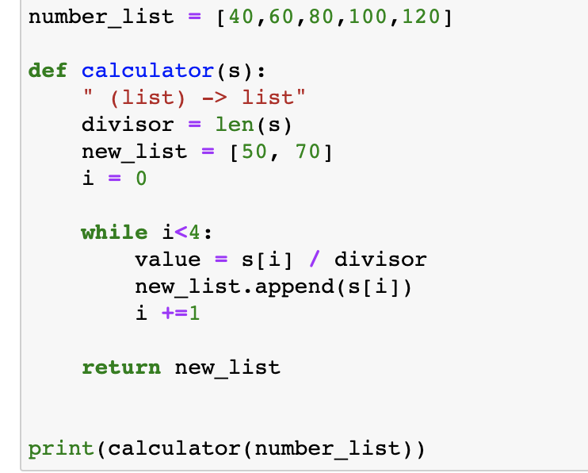
What is the output?
Return of the Jedi · $1000
Question board
Notes:
[50, 70, 40, 60 , 80 100]

Slide 11
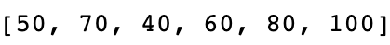
What is the output?
Return of the Jedi · $1000
Question board
Notes:
[50, 70, 40, 60 , 80 100]

Slide 12
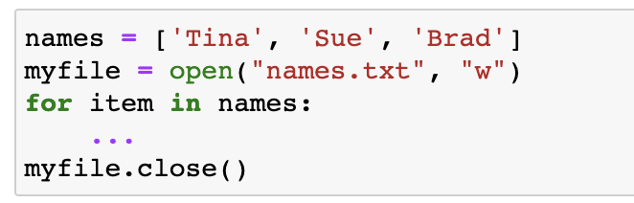

What is the missing line of code to write the names into names.txt?
File and Furious · $250
Question board
Notes:
Myfile.write(item + ‘\n’)

Slide 13
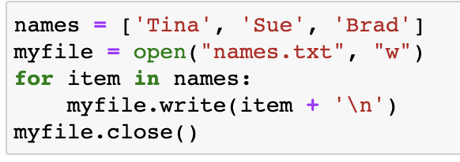
What is the missing line of code to write the names into names.txt?
File and Furious · $250
Question board
Notes:
Myfile.write(item + ‘\n’)

Slide 14
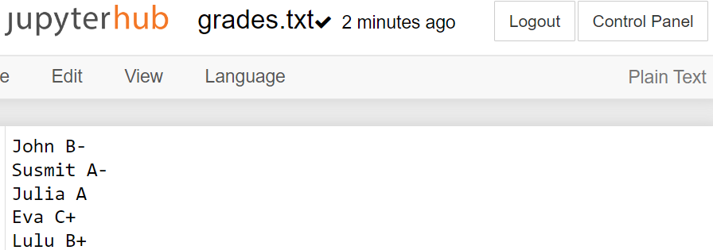
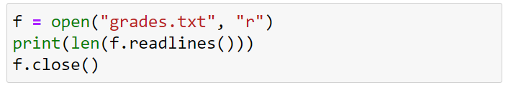
What is the output?
File and Furious · $500
Question board
Notes:
5

Slide 15
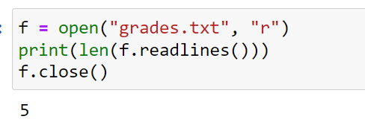
What is the output?
File and Furious · $500
Question board
Notes:
5

Slide 16
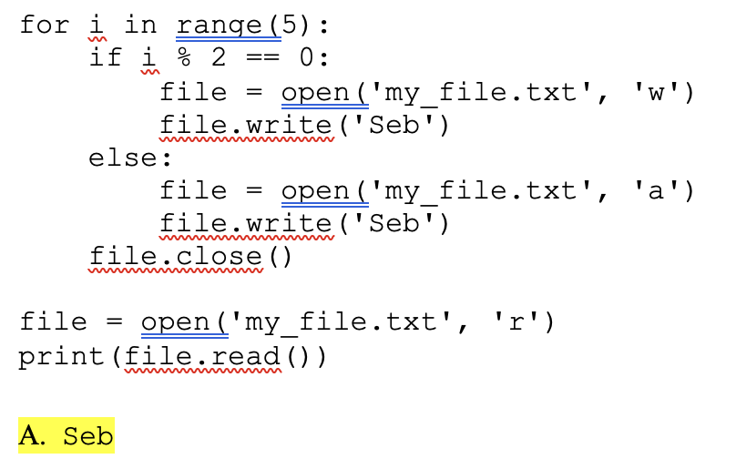
What is the output?
File and Furious · $750
Question board
Notes:
Seb

Slide 17
What is the output?
File and Furious · $750
Question board
Notes:
Seb

Slide 18
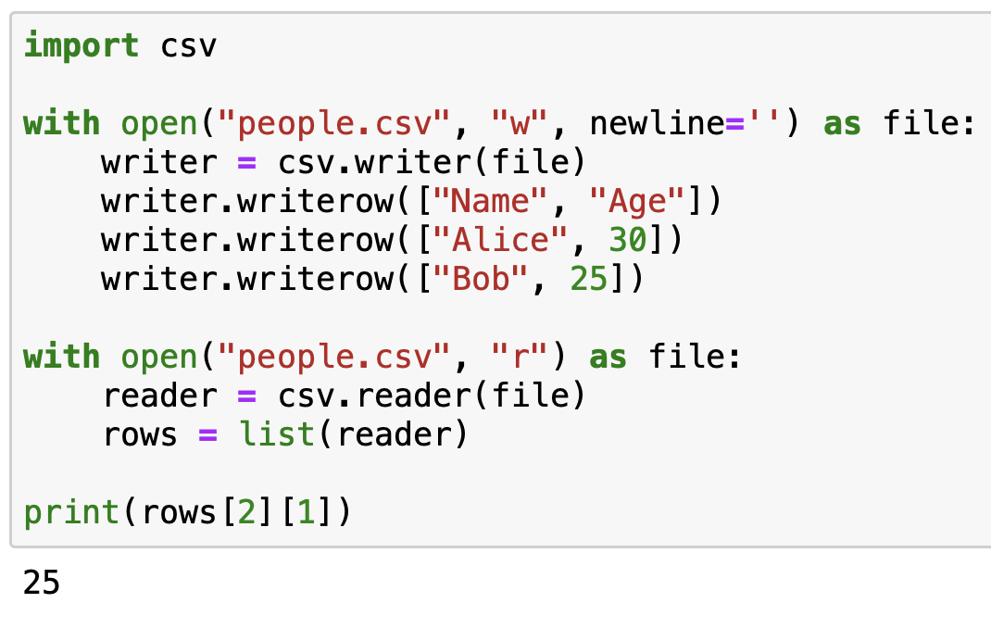
What is the output?
File and Furious · $1000
Question board
Notes:
25

Slide 19
What is the output?
File and Furious · $1000
Question board
Notes:
25

Slide 20
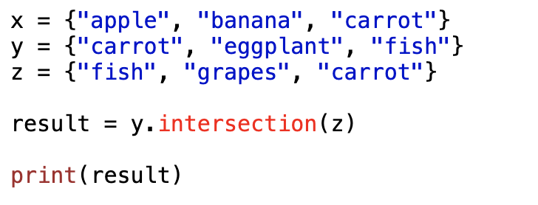
What is the output?
Key to the Set · $250
Question board
Notes:
{fish, carrot}

Slide 21

What is the output?
Key to the Set · $250
Question board
Notes:
{fish, carrot}

Slide 22
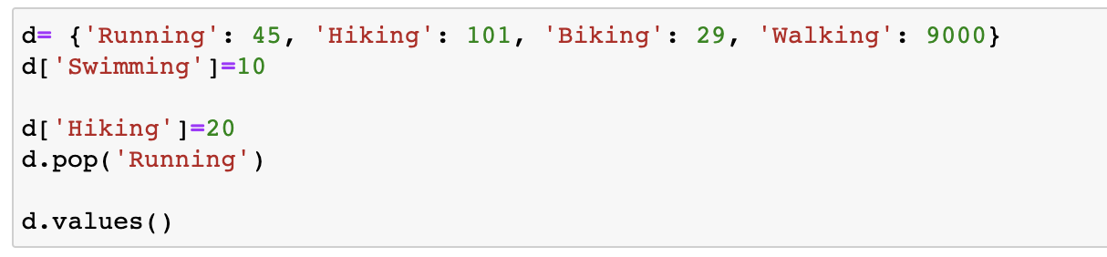
What will this code output?
Key to the Set · $500
Question board
Notes:
Dict_values([20, 29, 9000, 10])

Slide 23
What will this code output?
Key to the Set · $500
Question board
Notes:
Dict_values([20, 29, 9000, 10])

Slide 24
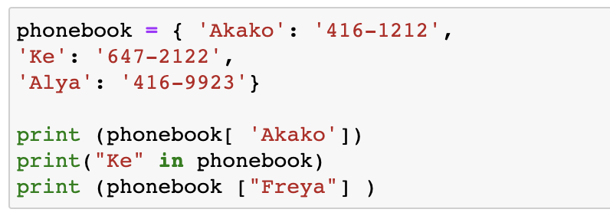
What will the code output?
Key to the Set · $750
Question board
Notes:
416-1212
True
Error

Slide 25
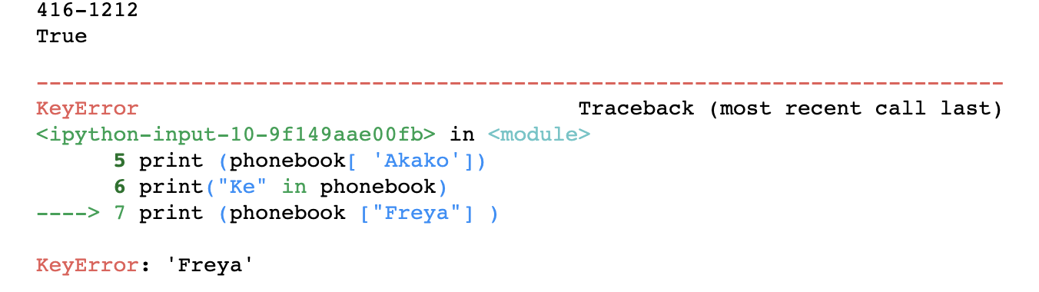
What will the code output?
Key to the Set · $750
Question board
Notes:
416-1212
True
Error

Slide 26
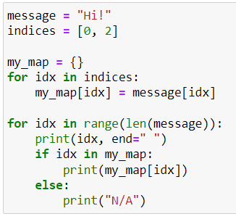
What is the output?
Key to the Set · $1000
Question board
Notes:
0 H
1 N/A
2 !

Slide 27

What is the output?
Key to the Set · $1000
Question board
Notes:
0 H
1 N/A
2 !

Slide 28
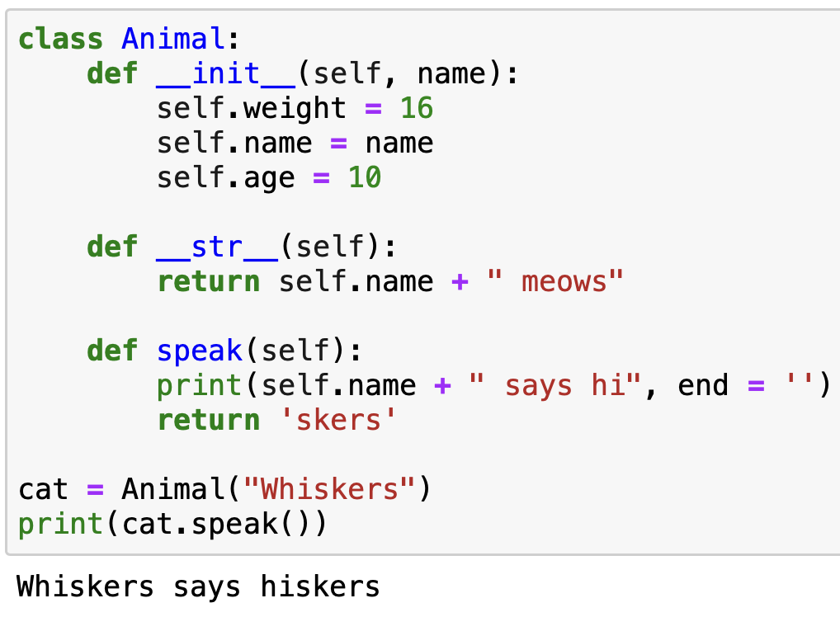
What is the output?
Classablanca · $250
Question board
Notes:
Whiskers says hiskers

Slide 29
What is the output?
Classablanca · $250
Question board
Notes:
Whiskers says hiskers

Slide 30
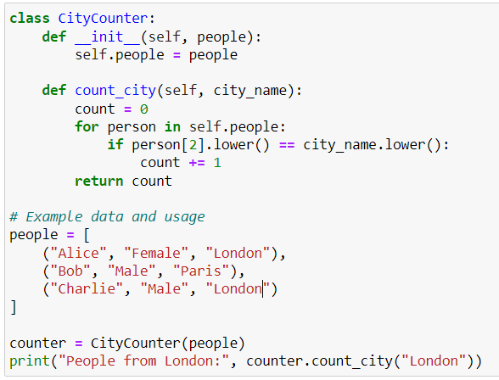
What is the output?
Classablanca · $500
Question board
Notes:
People from London: 2

Slide 31
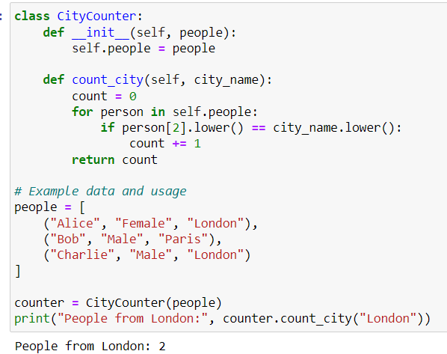
What is the output?
Classablanca · $500
Question board
Notes:
People from London: 2

Slide 32
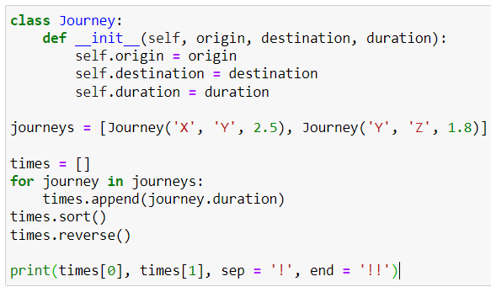
What is the output?
Classablanca· $750
Question board
Notes:
2.5!1.8!!

Slide 33
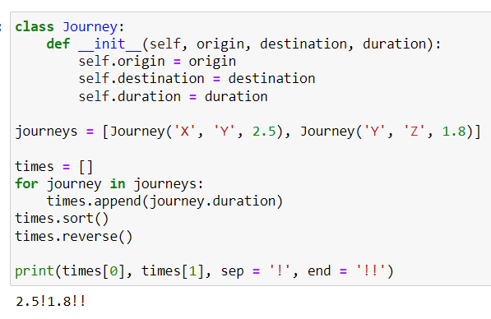
What is the output?
Classablanca· $750
Question board
Notes:
2.5!1.8!!

Slide 34
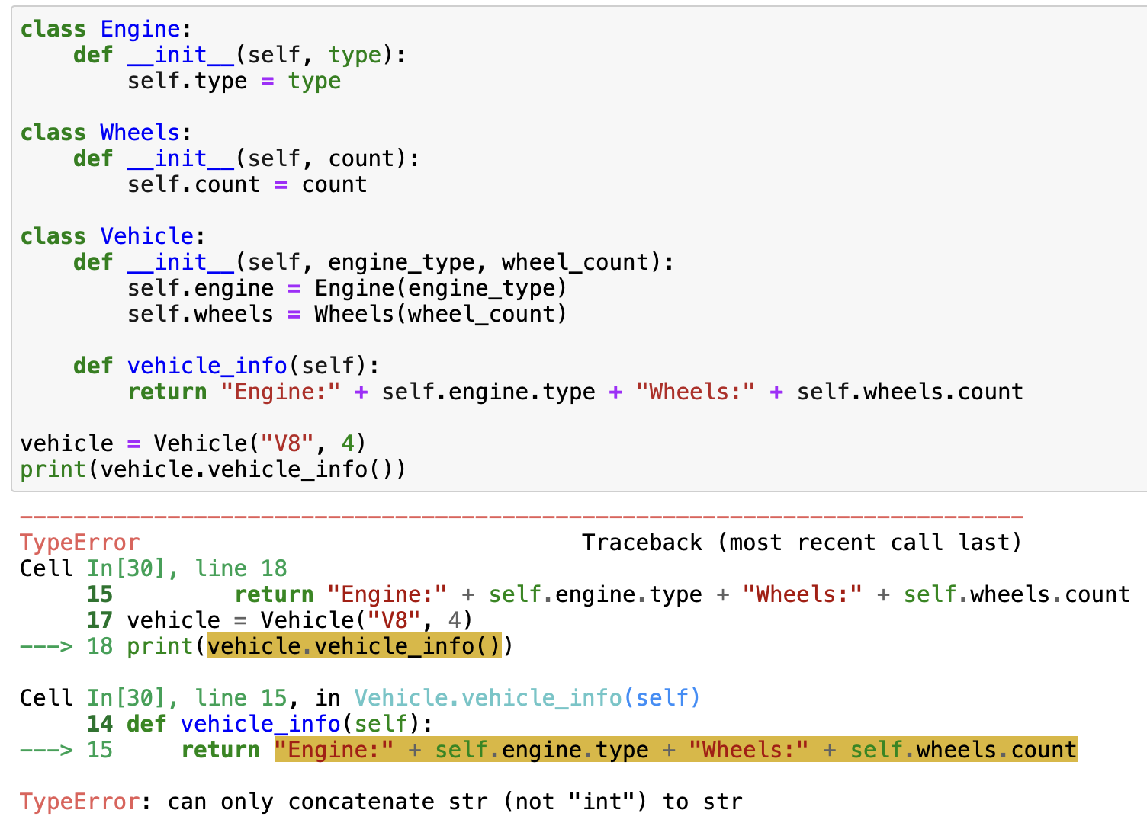
What is the output?
Classablanca · $1000
Question board
Notes:
Error

Slide 35
What is the output?
Classablanca · $1000
Question board
Notes:
Error

Slide 36
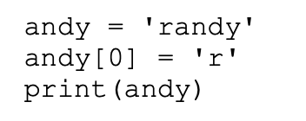
What is the output?
The Hitchhiker's Guide to Python · $250
Question board
Notes:
Error

Slide 37
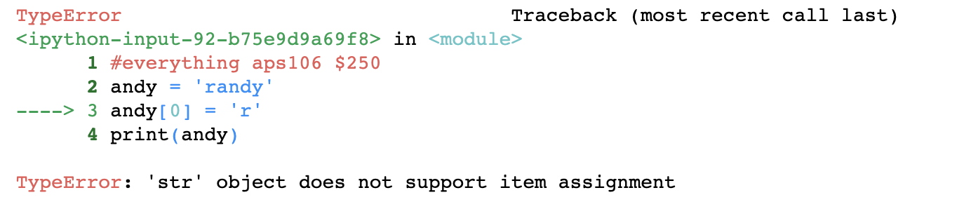
What is the output?
The Hitchhiker's Guide to Python · $250
Question board
Notes:
Error

Slide 38
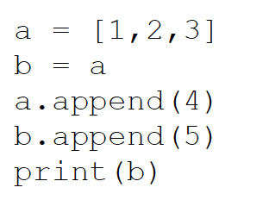
What is the output?
The Hitchhiker's Guide to Python · $500
Question board
Notes:
[1,2,3,4,5]

Slide 39

What is the output?
The Hitchhiker's Guide to Python · $500
Question board
Notes:
[1,2,3,4,5]

Slide 40
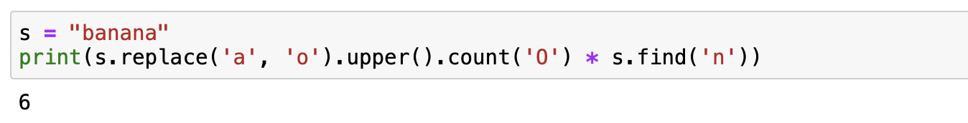
What is the output?
The Hitchhiker's Guide to Python · $750
Question board
Notes:
6

Slide 41
What is the output?
The Hitchhiker's Guide to Python · $750
Question board
Notes:
6

Slide 42
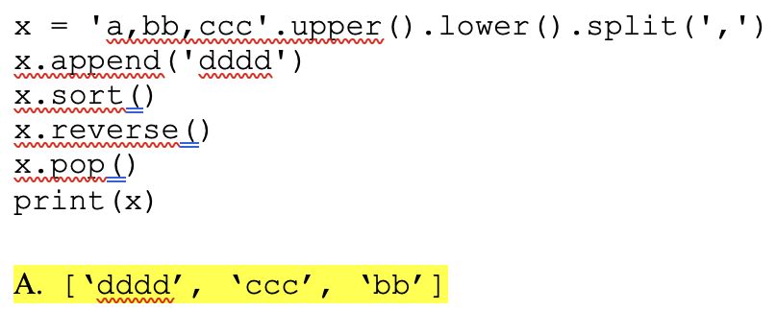
The Hitchhiker's Guide to Python · $1000
Question board
Notes:
[‘dddd’, ‘ccc’, ‘bb’]

Slide 43
The Hitchhiker's Guide to Python · $1000
Question board
Notes:
[‘dddd’, ‘ccc’, ‘bb’]

Slide 44
Final Jeopardy

Slide 45
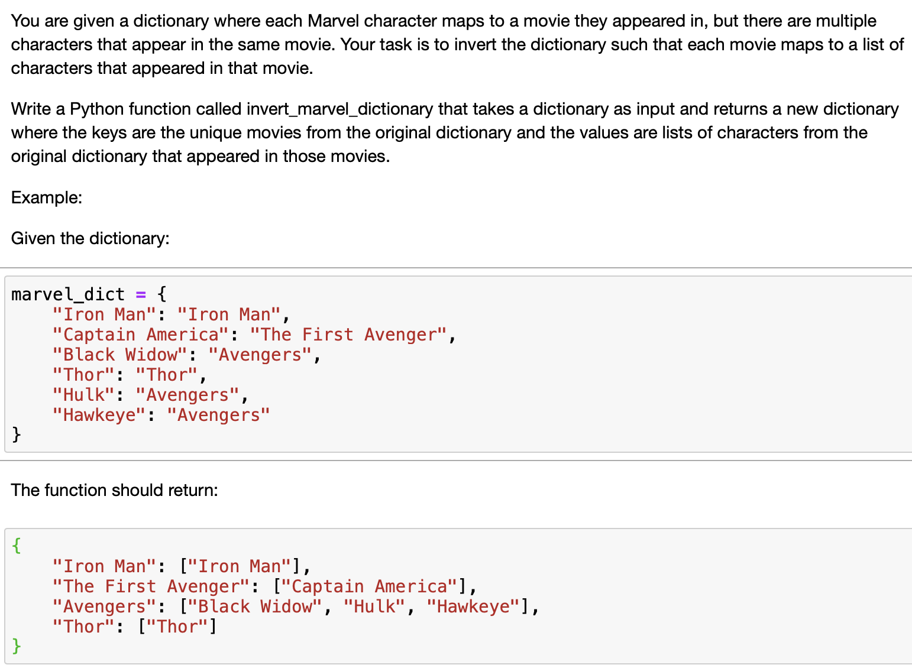
Question 1· FINAL JEOPARDY

Slide 46
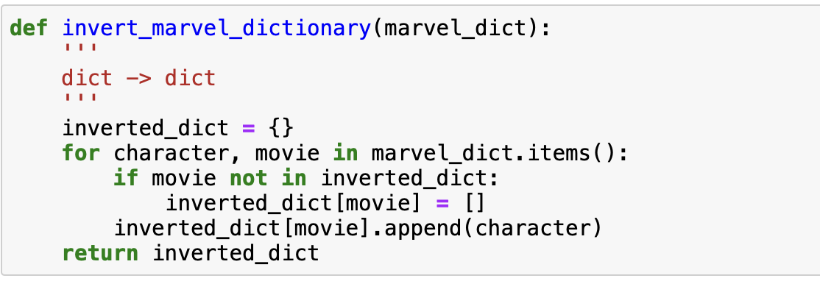
Question 1· FINAL JEOPARDY

Slide 47
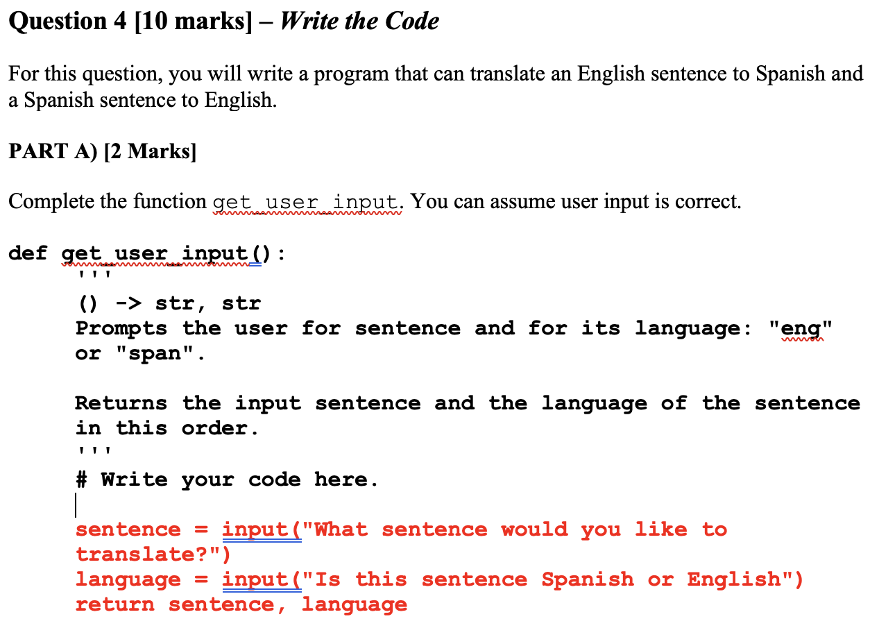
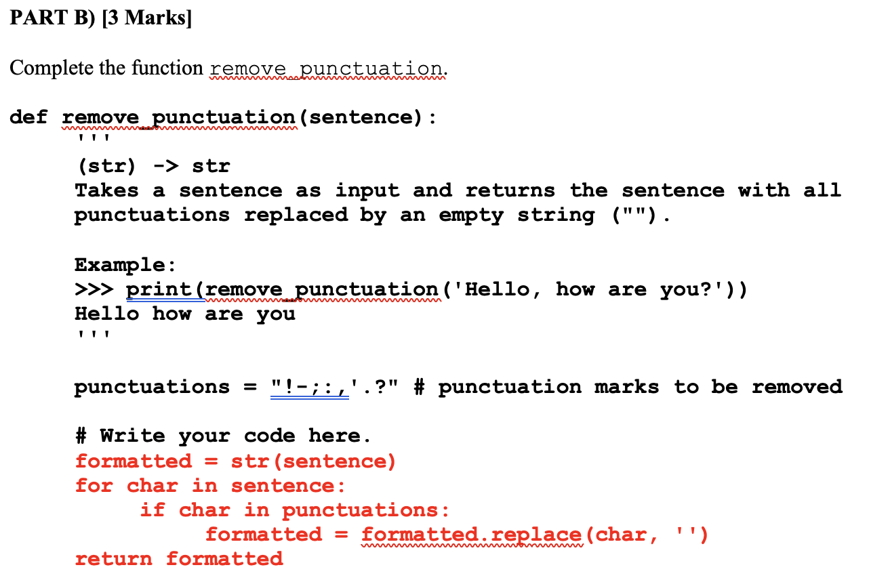
Question 2 · FINAL JEOPARDY

Slide 48
Question 2 · FINAL JEOPARDY

Slide 49
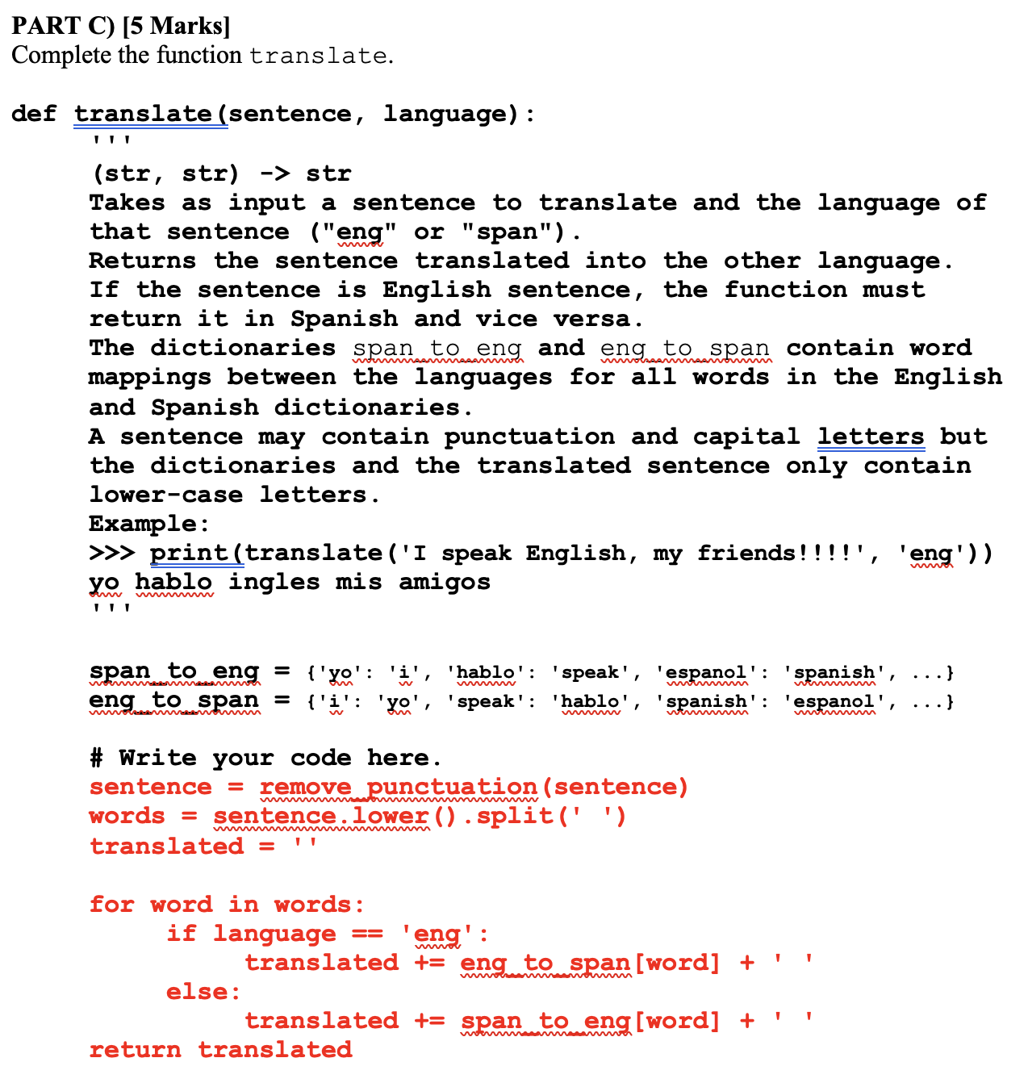
Question 2 · FINAL JEOPARDY

Slide 50
Question 2 · FINAL JEOPARDY

